Slide 1
Fundamentals of Accelerated Data Science
NVIDIA Deep Learning Institute

Slide 2
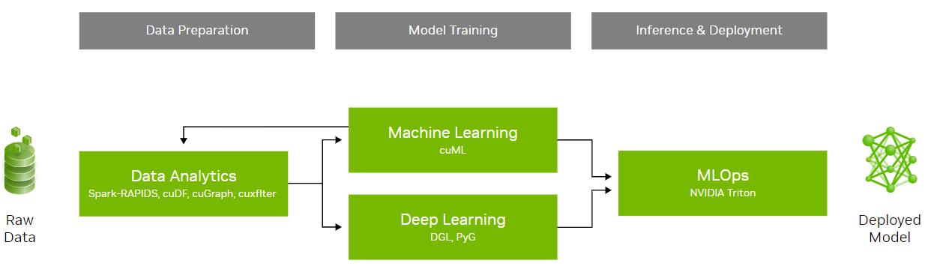
What This Course Will Cover
An introduction to data science with a focus on speed and efficiency
Learning objectives:
Overview of data science
Demonstrations of accelerated data science pipelines
How acceleration is achieved and its implications
This workshop will not cover:
Neural networks (accelerated by cuDNN)
Statistical analysis
 | Course Outline
Task 1 | Data science overview Data manipulation
Task 2 | Machine learning
Task 3 | Graph analytics
Coding Assessment | Biodefense

Slide 3
Agenda
• | Machine Learning Fundamentals
• | End-To-End Machine Learning
• | Accelerating Machine Learning
• | Hands-On Lab

Slide 4

Machine Learning
Data, algorithm, and compute
Machine learning primarily focuses on building algorithms that enable computers to learn from data and make predictions. In contrast, data science has a broader focus that encompasses various techniques for extracting insights and meaning from data, including statistical analysis and data visualization.
Pillars of machine learning:

Slide 5
Traditional Programming: Rules-Based
Explicitly define rules and logic to follow
Rules-based
Training
Inference
rules
input
output
input
learning algorithm
model
output
new input
model
prediction
new input
prediction
new input
prediction

Slide 6
Model Training
Models learn patterns from data to make predictions or decisions without explicit programming
Rules-based
Training
Inference
rules
input
output
input
learning algorithm
model
output
new input
model
prediction
new input
prediction
new input
prediction

Slide 7
Inference
Process incoming data and producing results based on patterns learned during training
Rules-based
Training
Inference
rules
input
output
input
learning algorithm
model
output
new input
model
prediction
new input
prediction
new input
prediction

Slide 8
Supervised vs. Unsupervised
Trained on labeled data to make predictions or classifications on new, unseen data
Rules-based
Training
Supervised: Regression: predicting a continuous value Classification: predicting a discrete label
rules
input
output
input
learning algorithm
model
output

Slide 9
Supervised vs. Unsupervised
Identifying unknown patterns and structures in data without predefined categories
Rules-based
Training
Supervised: Regression: predicting a continuous value Classification: predicting a discrete label | Unsupervised: Clustering: grouping data points together Dimensionality reduction while retaining information
rules
input
output
input
learning algorithm
model
X
output

Slide 10

Lifelong Learning
Allows models to update and improve their performance as new data becomes available
 | Continuous Learning: Compare predictions with actual results to identify data drift Update model (retrain) with new data Enables systems to automatically improve their performance through experience, making it a powerful tool for data-driven decision-making and automation across various domains
Training
Inference
input
learning algorithm
model
output
new input
model
prediction
new input
prediction
new input
prediction

Slide 11
Common Use Cases
Benefits:
Adaptability: models can adapt to new data, new tasks, and improve over time with retraining
Problem solving: excels at complex problems where patterns are not easily discernible
 | Supervised | Unsupervised
Online Services | Spam / Not Spam Predict Probability Customer Will Click on Ad | Group Articles into Categories Similar Search Results
Financial Services | Credit Card Fraud | Anomaly Detection
Telecom | Predict Customer Churn
Health Care | Probability of Readmission Predict Days of Hospital Stay | Patient Similarity
Real Estate | Predict House Price
Retail | Prejudice Price Forecast Sales Sentiment Analysis | Similar Customers Product Similarity Customer Group Products Which Are Purchased Together

Slide 12
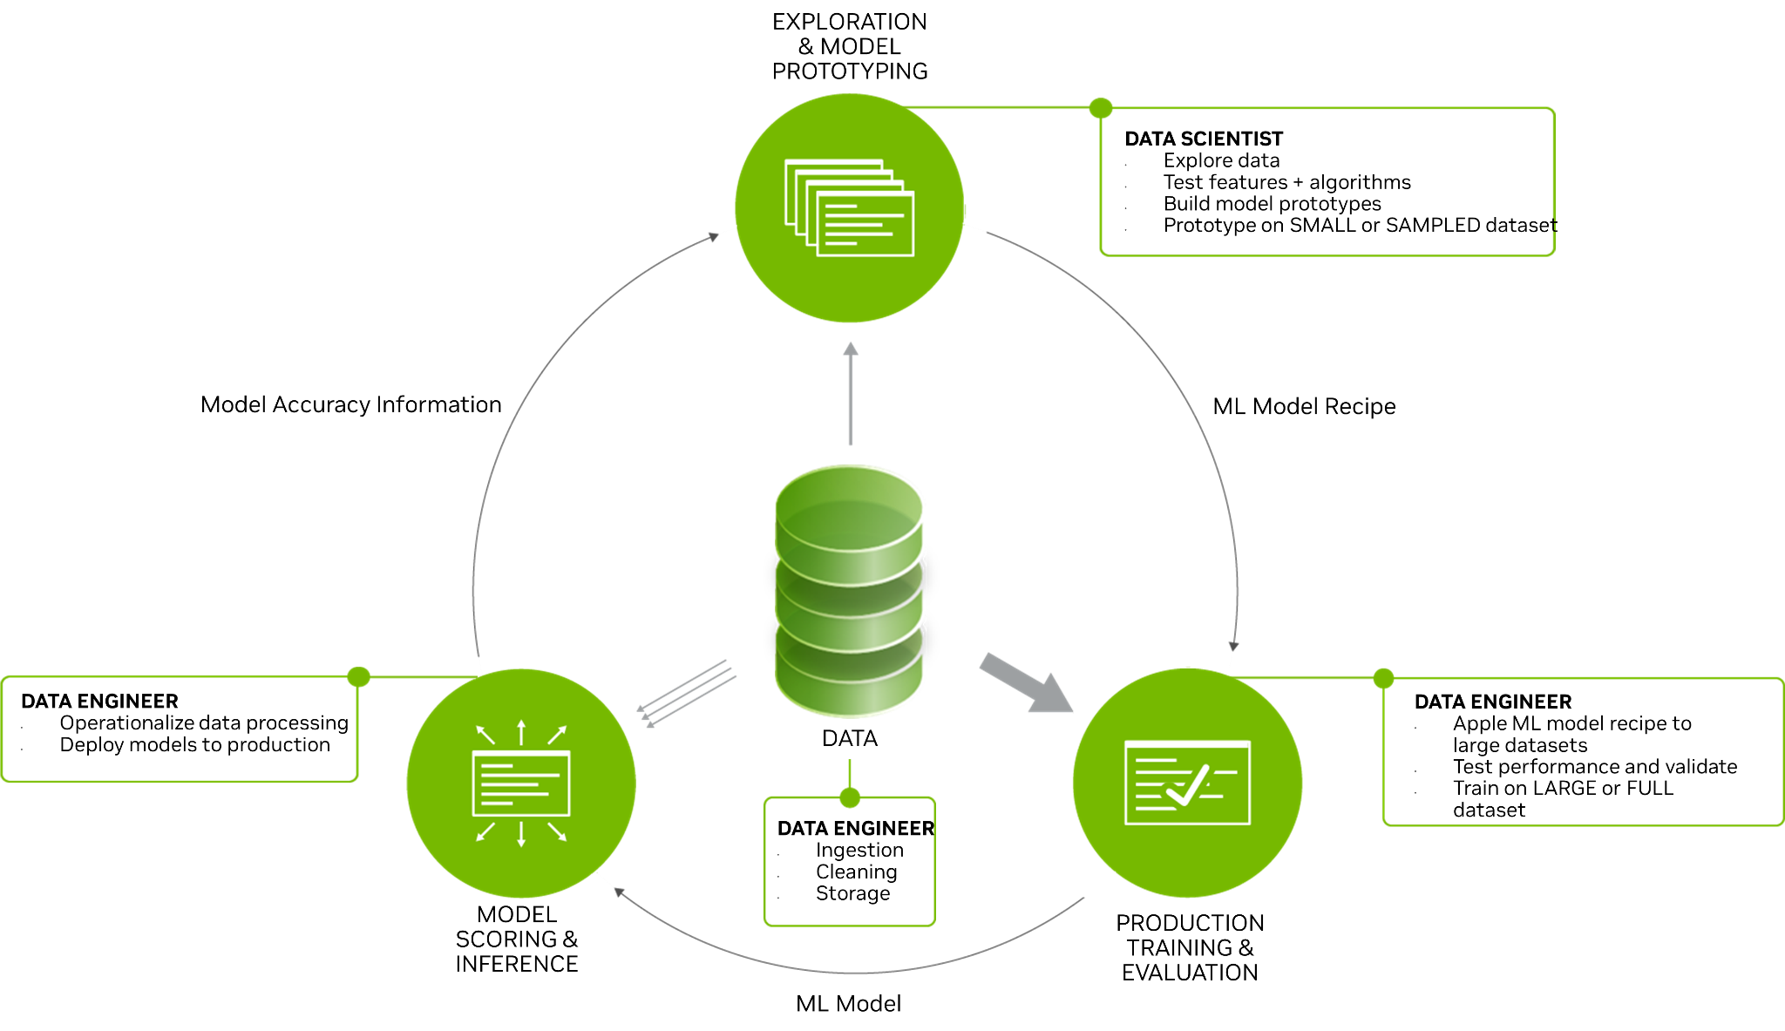
Machine Learning Lifecycle
Model development-> evaluation -> deployment
Machine learning is not a linear process
Benefits of accelerated data science workflows:
Higher productivity
More explorations and iterations can improve model accuracy and optimize inference performance
Lower time to insight and total cost of ownership

Slide 13
Model Evaluation
Assessing the quality and performance of a trained machine learning model
Assessing the performance and quality of a trained machine learning model using different metrics and techniques
To understand how well the model generalizes to unseen data and makes accurate predictions:
Underfit
Overfit
Data leakage
Employing appropriate metrics based on the type of problem:
Classification: accuracy, precision, recall, F1-score, ROC-AUC, confusion matrix
Regression: R-squared, MSE, RMSE, MA
Using techniques likes:
Cross-validation
Holdout validation
Bootstrapping
Accuracy

Slide 14
Model Evaluation
Assessing the quality and performance of a trained machine learning model
Latency: the time it takes for a model to generate predictions or outputs when given input data
Throughput: the amount of outputs it can perform in a given time, which is important for applications handling large volumes of data
Ensuring that optimizations for speed don't significantly degrade the model's accuracy or performance on its intended task
Evaluating how well the inference performance scales with increasing data volumes or concurrent requests
Inference Performance
Low Latency
High Throughput

Slide 15
Model Evaluation
Finding the balance between speed and accuracy
Larger and More Complex Models = Higher Accuracy = Lower Inference Performance
Accuracy
Inference Performance
Low Latency
High Throughput

Slide 16
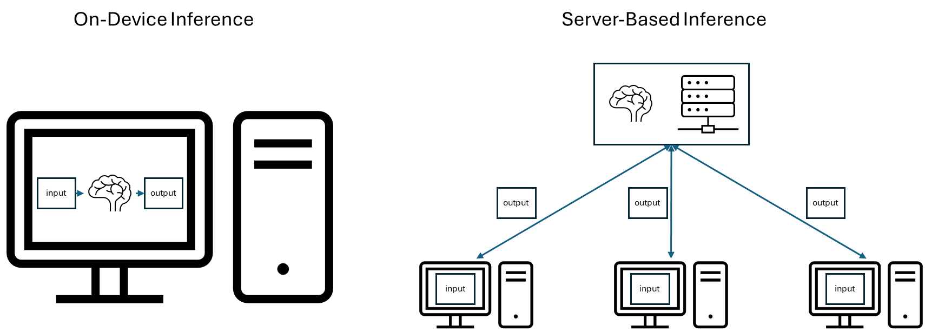
Model Deployment
On-device vs. server-based

Slide 17
Model Deployment
On-device vs. server-based

Slide 18
Triton Inference Server
Open-source inference serving software that is designed for deploying AI models at scale
Key Features:
Multi-framework support (TensorFlow, PyTorch, ONNX, etc.)
Concurrent model execution
Dynamic batching for improved performance
Model versioning and ensembling
Benefits for Data Scientists:
Simplifies model deployment in production environments
Enables efficient scaling of machine learning models
Provides a consistent interface across different ML frameworks

Slide 19
Triton Inference Server - Performance Analyzer
Command-line tool for benchmarking and analyzing Triton server performance
$ perf_analyzer -m inception_graphdef --concurrency-range 1:4 *** Measurement Settings *** Batch size: 1 Measurement window: 5000 msec Latency limit: 0 msec Concurrency limit: 4 concurrent requests Using synchronous calls for inference Stabilizing using average latency Request concurrency: 1 Client: Request count: 339 Throughput: 67.8 infer/sec Avg latency: 14710 usec (standard deviation 2539 usec) p50 latency: 13665 usec ... Request concurrency: 4 Client: Request count: 415 Throughput: 83 infer/sec Avg latency: 48064 usec (standard deviation 6412 usec) p50 latency: 47975 usec … Inferences/Second vs. Client Average Batch Latency Concurrency: 1, throughput: 67.8 infer/sec, latency 14710 usec Concurrency: 2, throughput: 89.8 infer/sec, latency 22280 usec Concurrency: 3, throughput: 80.4 infer/sec, latency 37283 usec Concurrency: 4, throughput: 83 infer/sec, latency 48064 usec
Key Capabilities
Measures throughput, latency, and other performance metrics
Supports various input data types and shapes
Allows customization of test parameters (batch size, concurrency, etc.)
Benefits:
Optimizes model serving configurations
Identifies performance bottlenecks
Enables data-driven decisions for deployment strategies

Slide 20
Triton Inference Server - Model Analyzer
Command-line tool for optimizing model configurations on Triton
Features:
Automatically finds optimal configurations for models
Supports single, multiple, ensemble, and BLS models
Measures performance metrics like throughput, latency, and GPU utilization
Generates detailed reports and visualizations
Search Modes:
Quick Search: Uses heuristic algorithm for faster results
Automatic Brute Search: Exhaustive search of configuration parameters
Manual Brute Search: Allows custom parameter sweeps
Benefits:
Improves model serving performance
Saves development time
Maximizes hardware utilization
Helps meet application constraints (latency, throughput, memory)

Slide 21
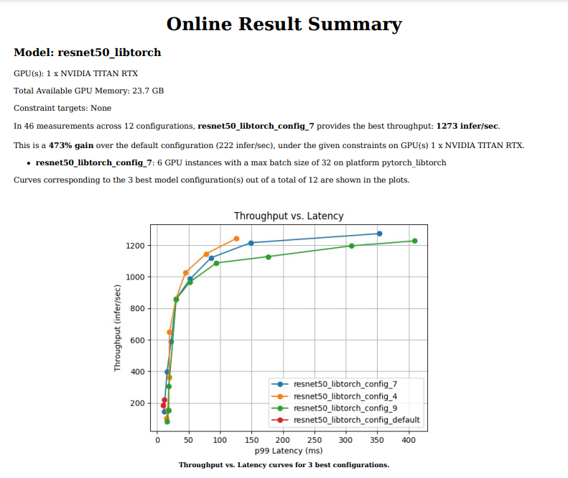
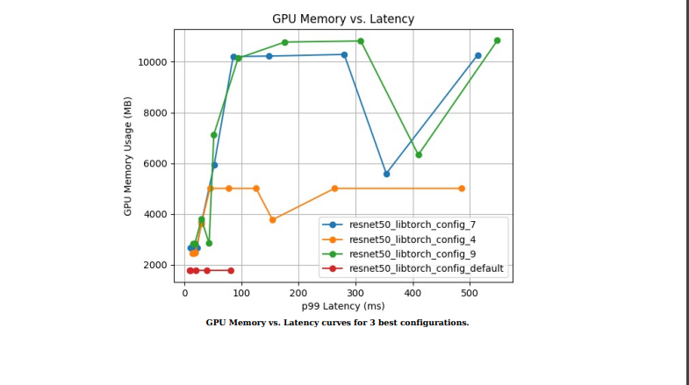
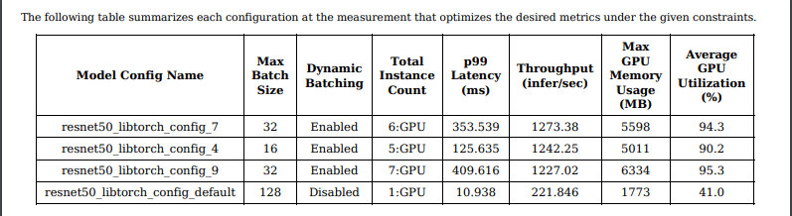
Example of Model Analyzer Report

Slide 22
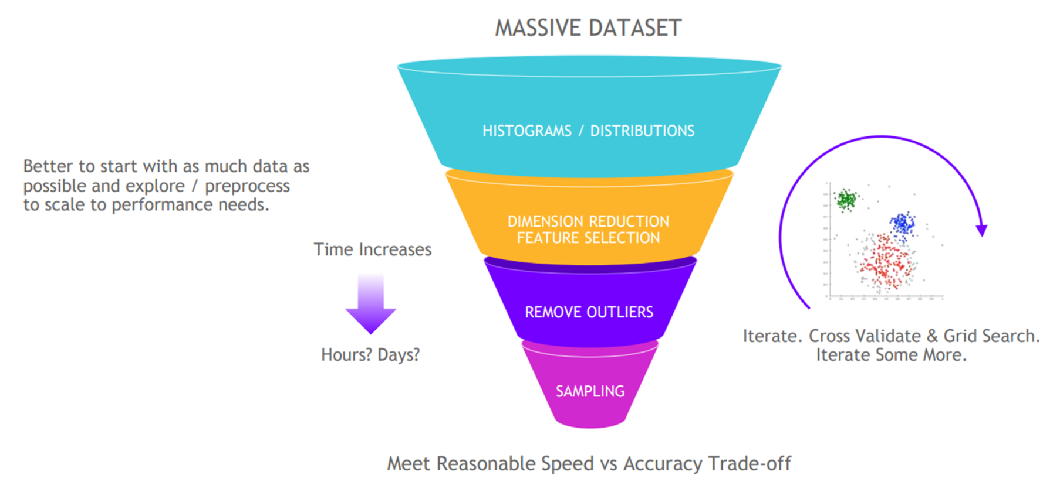
Challenges in Machine Learning
More data requires more compute
Data quality and quantity directly impact model performance
High-quality data can be expensive to acquire
More data requires more compute and more efficient algorithms
Computational resources: training models on large datasets requires significant computational power
Hyperparameter tuning: finding optimal configurations for model hyperparameters in time-consuming
Continuous adaptation: models may become less accurate as environment changes over time - need for continuous monitoring and retraining
Talent shortage: lack of professionals with the right skills to develop systems effectively

Slide 23
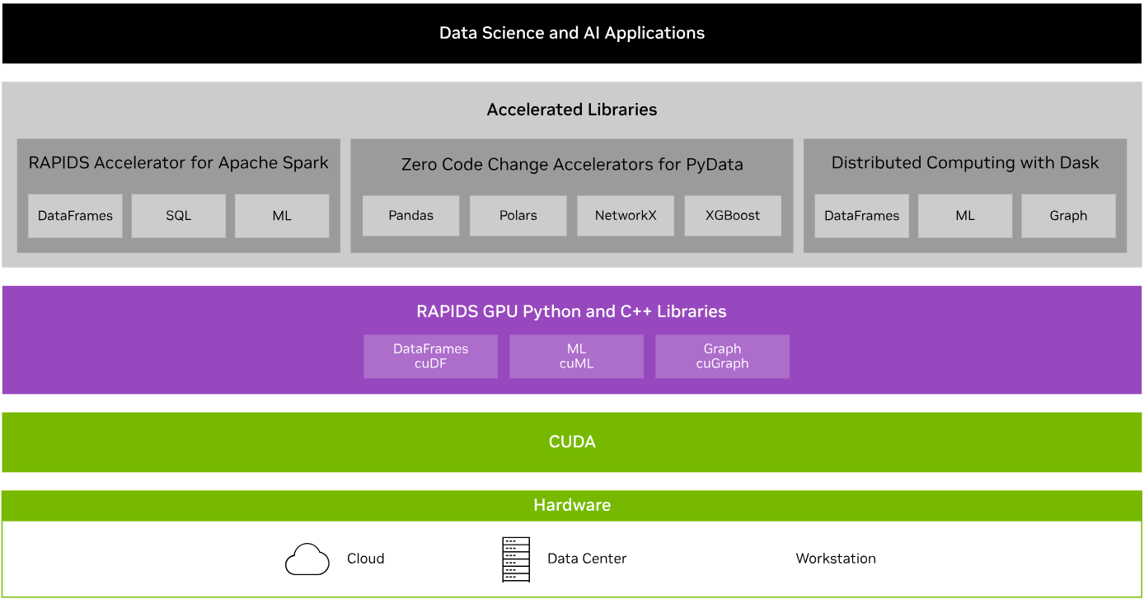
RAPIDS Transforms Data Science
An optimized hardware-to-software stack for the entire data science pipeline

Slide 24
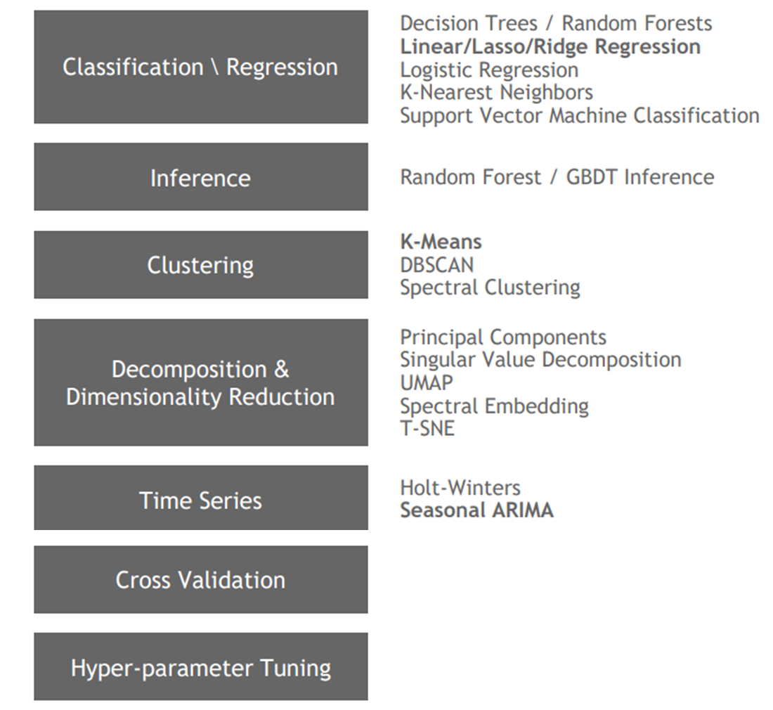
Machine Learning and AI Go Beyond Deep Learning
cuML + XGBoost libraries
GPUs are ubiquitous in Deep Learning, but >90% of enterprises are primarily using Machine Learning
Using CUDA ML primatives, the same matrix operations allow GPUs to be performant at Machine Learning as well
cuML is the Python bindings to the C++/CUDA based cuML algorithms that uses cuDF Dataframes as input
Dask enables distributed cuML model training
Can easily run multiple Dask workers per node to allow for an easier development model of one worker per GPU regardless of single node or multi node environment

Slide 25
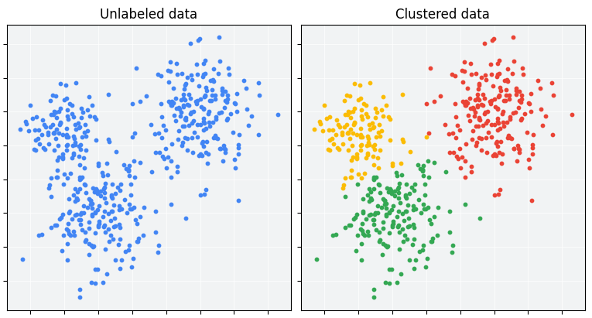
Clustering
Group unlabeled examples based on their similarity to each other
 | K-Means | DBSCAN
Approach | Partitions data by iteratively moving cluster centers and re-assigning data points based on which center is closest to the point | Uses spatial density to cluster—finds cluster points within at most epsilon distance of another point in the cluster
Pros | Fast, simple, and easy to understand Scalable to large datasets | Can identify clusters of any arbitrary shapes Automatically determines the number of clusters Robust to outliers
Cons | Assumes spherical clusters Requires specifying the number of clusters in advance Sensitive to outliers | Less efficient for very large datasets Requires specifying minimum points and maximum neighborhood distance
Use cases:
Market segmentation
Anomaly detection
Imputation

Slide 26
Classification
 | K-Nearest Neighbors | Logistic Regression |  | Decision Tree
Approach | KNN makes predictions based on the similarity of new data points to known examples in the training set. The algorithm calculates the distance between the new point and all points in the training set. It identifies the K nearest neighbors and uses majority voting among the K neighbors | Logistic regression is a statistical method used for binary classification. It predicts the probability of an instance belonging to a particular class, using the logistic function (sigmoid) to map predictions to probabilities between 0 and 1 |  | Creates a tree-like model of decisions based on features in the data. From the root node, it splits the data into subsets based on the most significant attributes. The splitting criteria is determined by maximizing information gain or minimizing impurity
Pros | Makes no assumption about data distribution “Lazy” learning algorithm Adapts quickly to new data | Generally efficient Less prone to overfitting |  | Does not require feature scaling Robust to outliers Can handle categorical variables Makes no assumption about data distribution
Cons | Prone to overfitting Sensitive to outliers Requires feature scaling High computational cost for large datasets, especially during prediction High memory requirement (needs to store the entire training dataset) | Sensitive to outliers Assumes linear relationship between features and log-odds of outcome Suitable for binary outcome Assumes no correlation between features Requires irrelevant features to be excluded Can overfit on high-dimensional datasets |  | Prone to overfitting Computationally expensive for large datasets

Slide 27
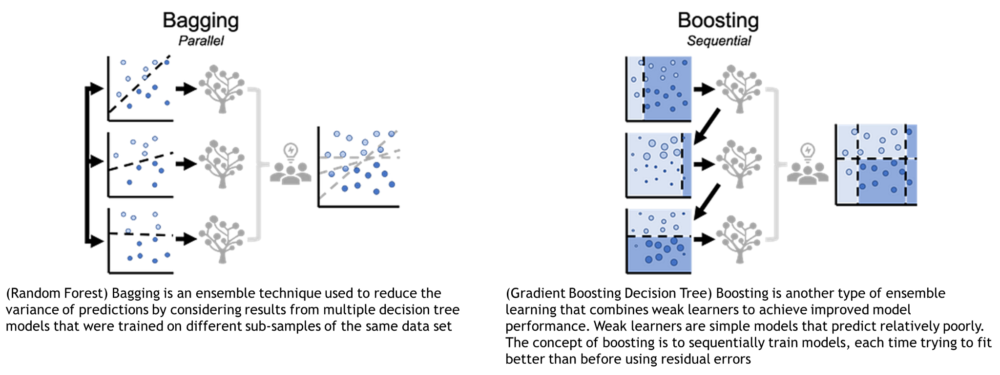
Ensemble
Using multiple decision trees

Slide 28
Ensemble
Using multiple decision trees

Slide 29

XGBoost + RAPIDS (LINK)
Optimized gradient boosting machine learning algorithm
XGBoost is the gold standard in single model performance for classification and regression. RAPIDS was built from the start to integrate with this amazing algorithm.
Extreme Gradient Boosting, is a scalable, distributed gradient-boosted decision tree machine learning algorithm
Builds upon supervised machine learning, decision trees, ensemble learning, and gradient boosting concepts
Gradient boosting is an extension of boosting where the process of additively generating weak models is formalized as a gradient descent algorithm over an objective function. Gradient boosting sets targeted outcomes for the next model to minimize errors
With XGBoost, trees are built in parallel. It follows a level-wise strategy, scanning across gradient values and using these partial sums to evaluate the quality of splits at every possible split in the training set
XGBoost includes seamless GPU acceleration, including loading data from cuDF DataFrames and cuPy arrays. This significantly speeds up model training and improves accuracy for better predictions. The Dask API makes it easy to scale to multiple nodes or multiple GPUs. Furthermore, the RAPIDS Memory Manager (RMM) integrates with XGBoost to enable a single, shared, high-speed memory pool

Slide 30
Acceleration

Slide 31
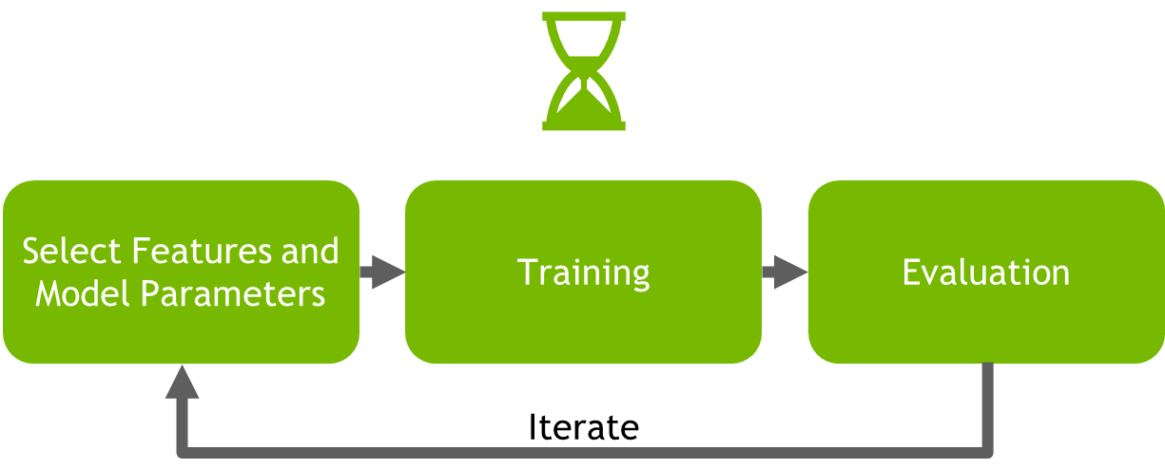
Model Tuning
Low data processing cycle time translates to more experimentation and higher productivity
Faster runtime means more experimentation to improve model performance
Faster runtime shortens development time and improves productivity
Cross validation – resampling method to protect against overfitting
Trains multiple models with different subsets
Feature selection – finding the optimal subset of features
Reduce noise and irrelevant features
Reduce model complexity and training time
Improve model inference performance
Hyperparameter Tuning
Grid Search

Slide 32
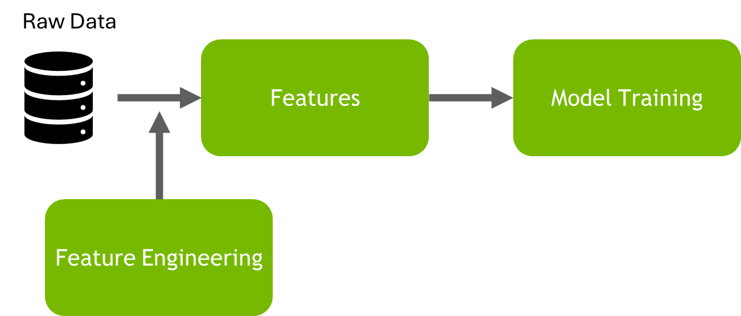
Feature Engineering
Accelerated by RAPIDS cuDF
Feature engineering is often considered one of the most crucial and impactful steps in the machine learning process to improve a model's predictive power and ability to generalize to new data
Benefits of feature engineering:
Transforms raw data into a format that better represents the underlying problem, making it easier for algorithms to learn patterns and make predictions
Allows domain knowledge to be incorporated into the model, capturing important aspects of the problem that may not be immediately apparent in the raw data
Enhance model interpretability, making it easier to understand and explain model predictions
Reduce computational costs and improve model efficiency by providing more relevant and informative inputs
Feature engineering is an iterative process that allows for continuous refinement and improvement of model inputs
Use cuDF to create new features for downstream ML tasks:
cuML
XGBoost
cuDNN

Slide 33
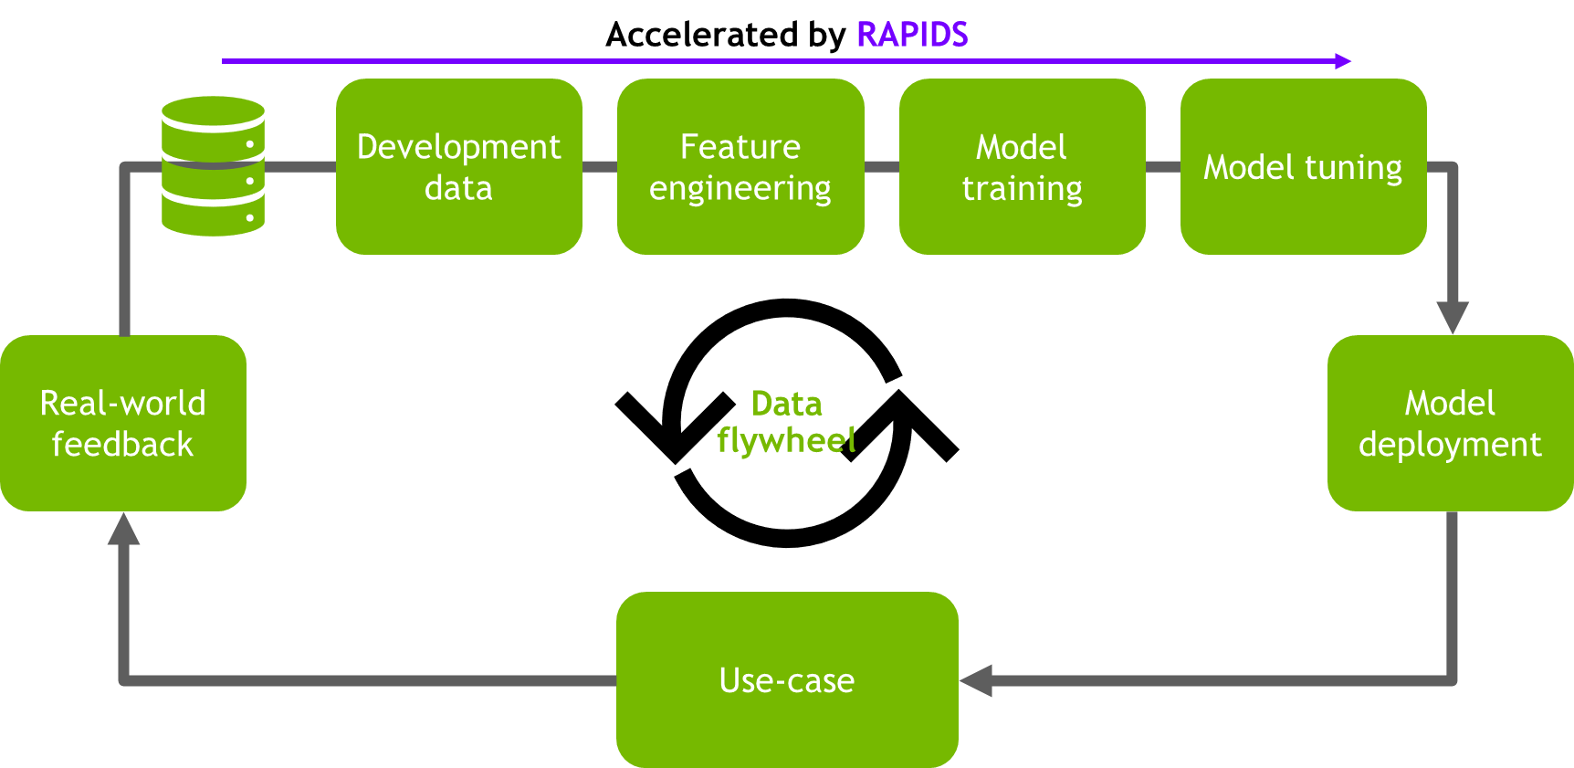
Data Flywheel
Powerful approach to identifying and fixing data shifts
Enables systems to automatically improve their performance through the cyclical nature of data-driven growth and innovation

Slide 34
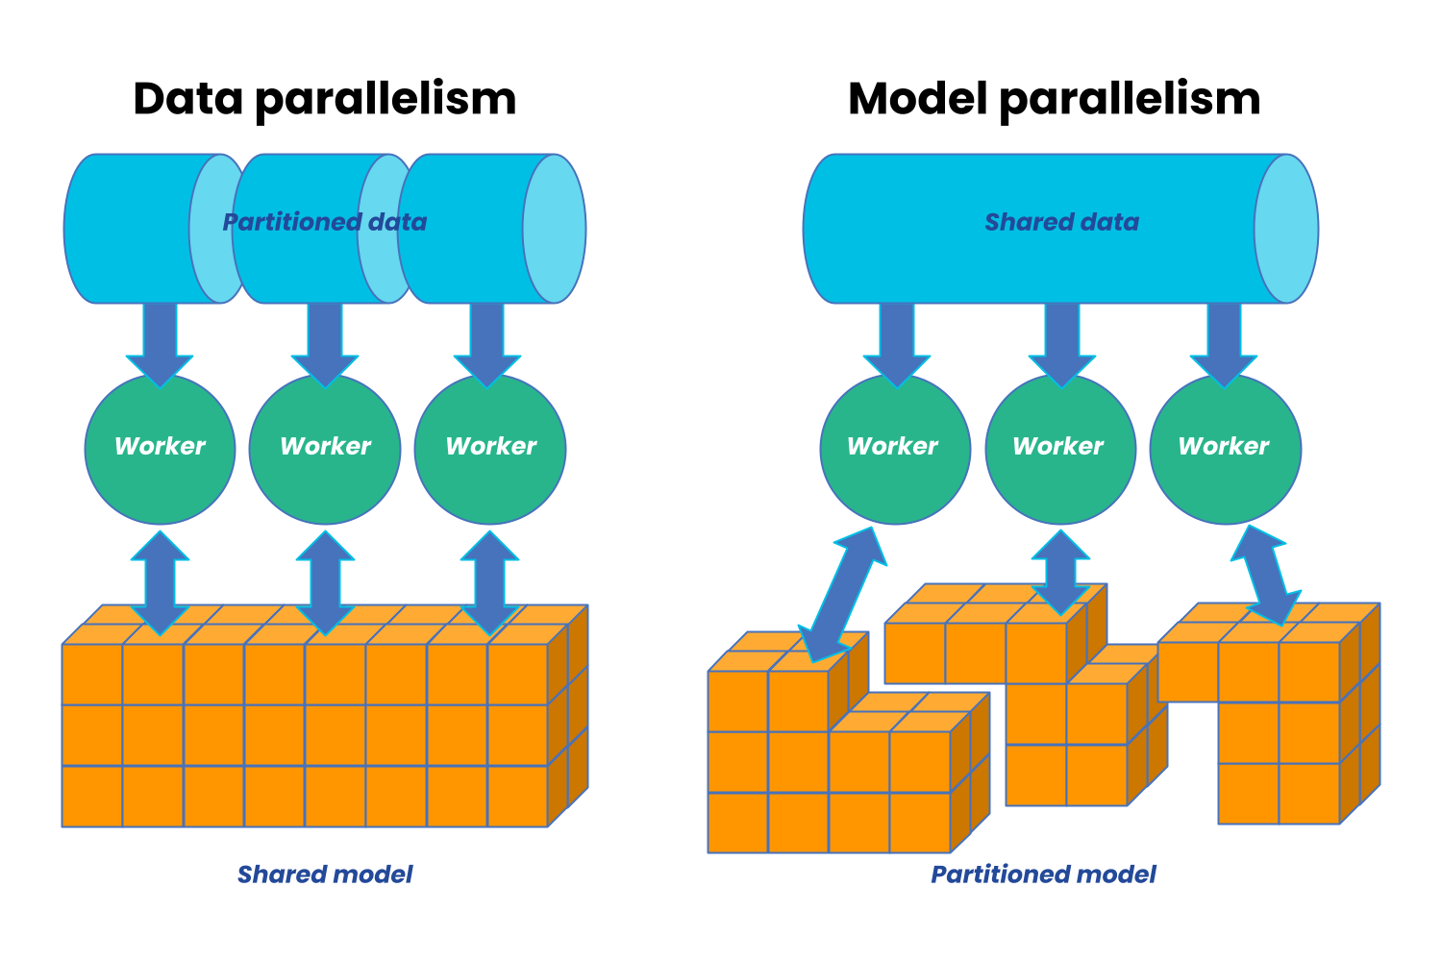
Distributed Computing for Machine Learning
When the training data or model doesn’t fit in the memory of a single device
The dataset is split across multiple devices, with each device having a full copy of the model
The model itself is split across multiple devices, with each device processing the same data but different parts of the model

Slide 35
Distributed Computing for Machine Learning
When the training data or model doesn’t fit in the memory of a single device
The dataset is split across multiple devices, with each device having a full copy of the model
The model itself is split across multiple devices, with each device processing the same data but different parts of the model

Slide 36
Case Studies

Slide 37
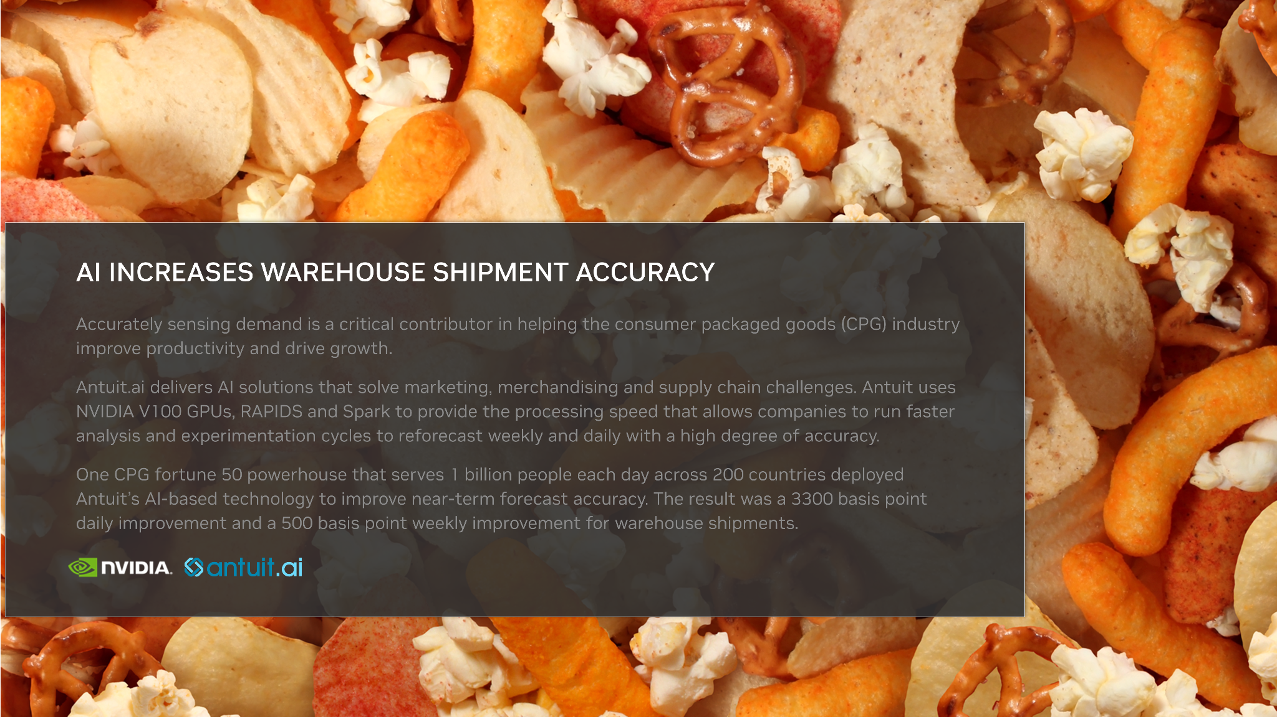
Case Study #1

Slide 38

Case Study #2

Slide 39
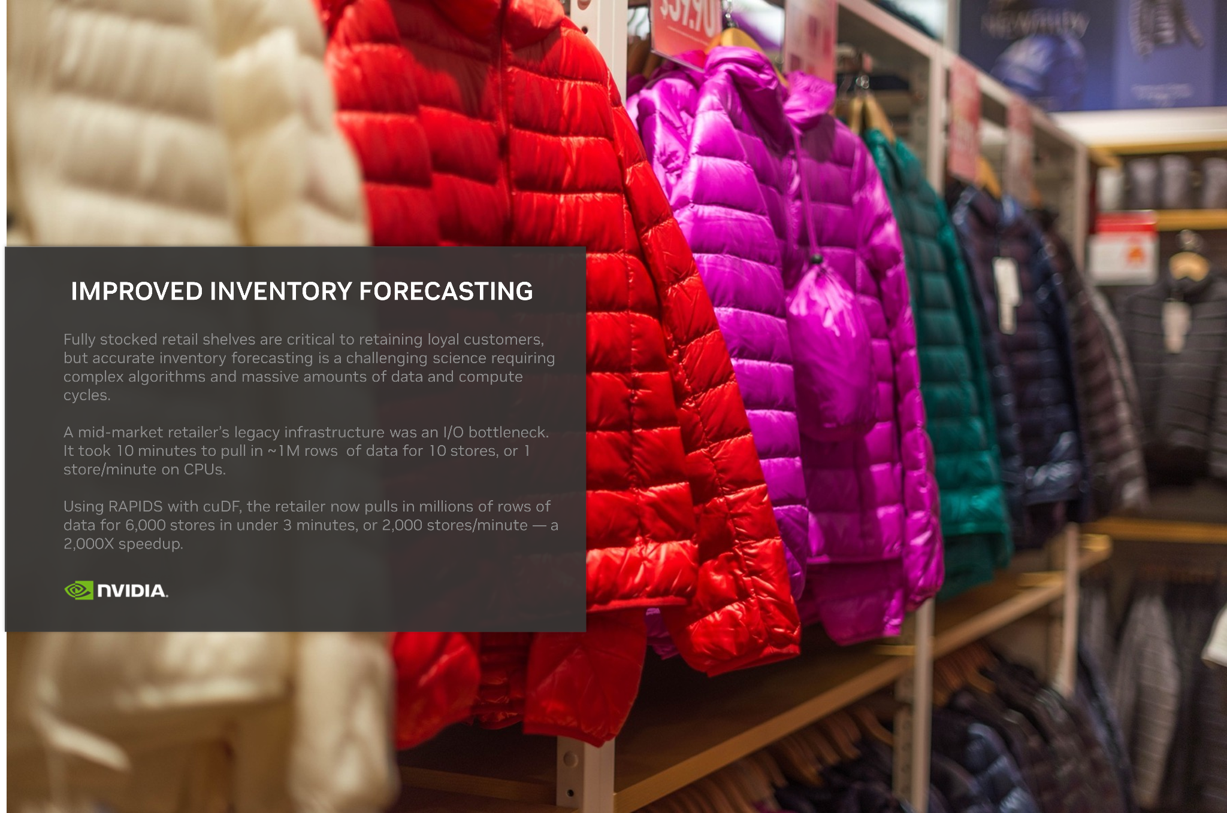
Case Study #3

Slide 40

Case Study #4

